Slide 1
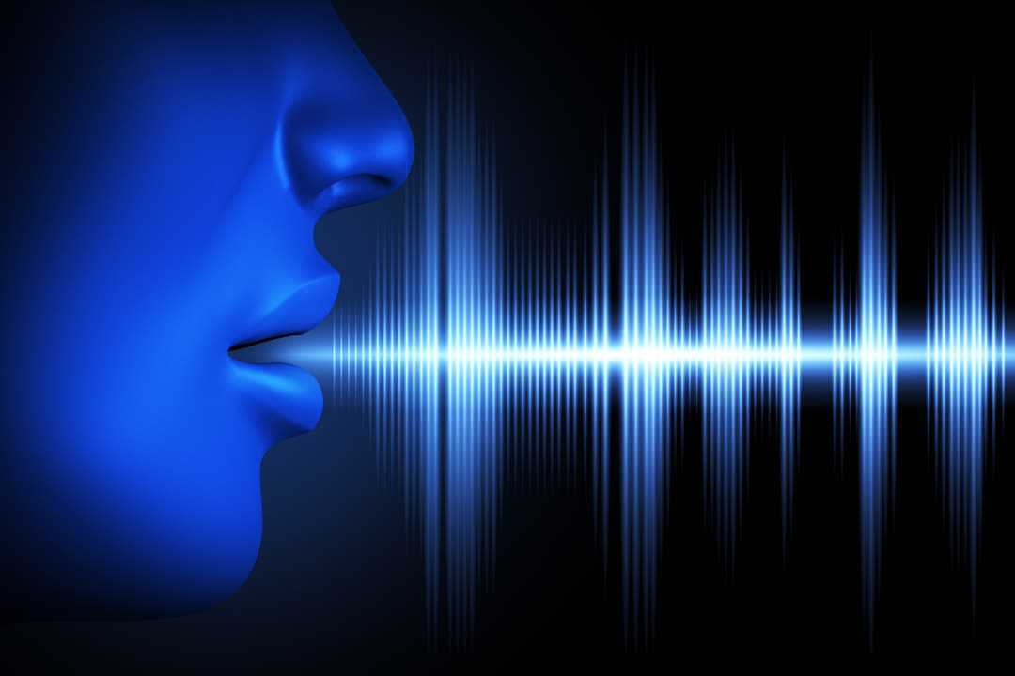
PREDICTION OF PARKINSON DISEASE USING SPEECH SIGNALS
PROJECT GUIDE:
MRS. DEEPA P
TEAM MEMBERS:
MADHUMITHA B D(2018PECCS159)
KEERTHIKA S(2018PECCS152)
HARSHINI C(2018PECCS137)
BATCH: DOMAIN:
A14 DEEP LEARNING

Slide 2
ABSTRACT
Parkinson’s disease (PD) is a degenerative neurological disorder marked by decreased dopamine levels in the brain.
There is commonly a marked effect on speech, including hypophonia (lowered volume), and monotone (reduced pitch range).
Additionally, cognitive impairments and changes in mood can occur, and risk of dementia is increased.
Traditional diagnosis of Parkinson’s disease involves a clinician taking a neurological history of the patient and observing motor skills in various situations.
Since there is no definitive laboratory test to diagnose PD, diagnosis is often difficult, particularly in the early stages when motor effects are not yet severe. Monitoring progression of the disease over time requires repeated clinic visits by the patient.

Slide 3
ABSTRACT
An effective screening process, particularly one that doesn’t require a clinic visit, would be beneficial.
Since PD patients exhibit characteristic vocal features, voice recordings are a useful and non-invasive tool for diagnosis.
If deep learning algorithms could be applied to a voice recording dataset to accurately diagnosis PD, this would be an effective screening step prior to an appointment with a clinician. . The past dataset is collected and that dataset is used to build a deep learning model.
The data is visualized for better understanding of the features and based on that a classification model is built by using deep learning algorithm and comparison of algorithms are done based on their performance metrics like accuracy, F1 score recall etc.

Slide 4
PROJECT DOMAIN
Parkinson’s Disease is a progressive neurodegenerative disorder manifesting with subtle the early signs, which often hinder timely and early diagnosis treatment.
The development of accessible, technology based methods for longitudinal PD symptoms tracking in daily living, offers the potential for transforming disease assessment and accelerating diagnosis.
A privacy aware method for classifying patients and healthy controls , on the grounds of speech impairment present in PD, is proposed.
Voice features from running speech signals were extracted from passive recordings over voice calls.
These voice features are extracted and implemented using Deep learning which is a relatively new approach within the field of neural networks.

Slide 5
PROJECT SCOPE
Parkinson’s disease a long term degenerative disorder of the central nervous system that affects the motor control of a patient by affecting predominately dopamine producing neurons in a specific area of the brain.
The main problem in detecting the disease timely is the visible symptoms appear mostly at the later stage where cure no longer becomes possible.
There is no correct reason proved yet that results to cause of Parkinson’s, hence scientists are still conducting extensive research to find out its exact cause.
Since PD patients have speech impairment , the voice features can be extracted from the patients in the earlier stage and the Parkinson disease can be diagnosed using deep learning approach

Slide 6
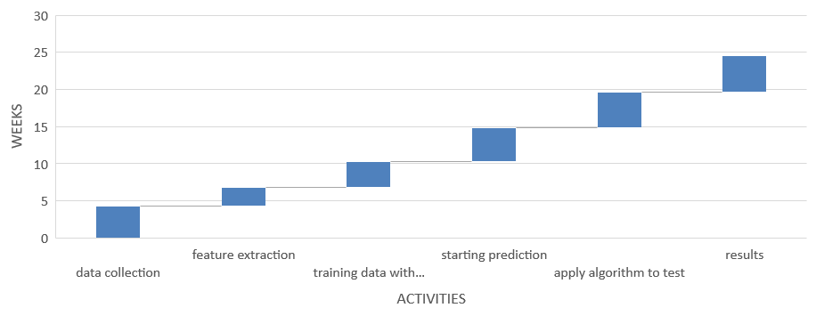
TIMELINE CHART

Slide 7
THANK YOU

